Slide 1
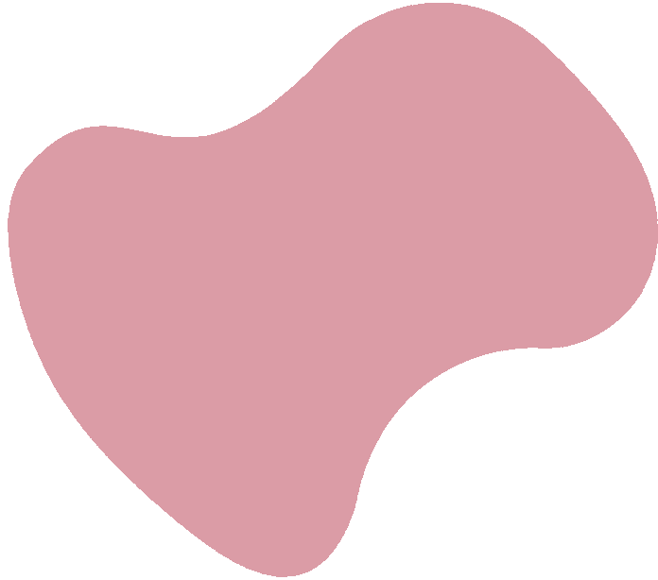
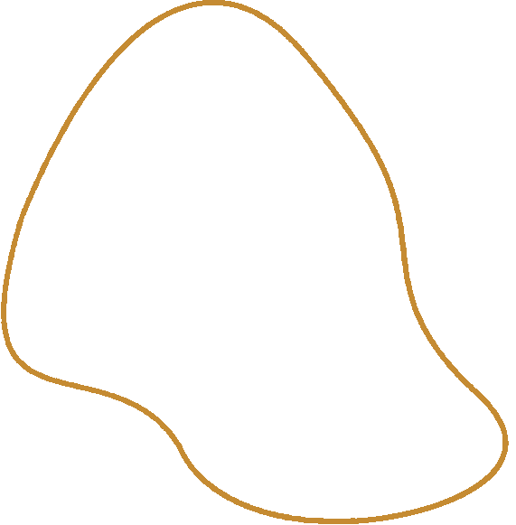


Deep Learning powered Fashion Recommendation System

Slide 2
Team Members:
S.SHAMYUKTHA 99220041872
M.KEERTHANA DEVI 99220041783
S.SANTHIYA 99220041869
J.SONA JASMINE 99220041873
P.VINEELA 99220041836

Slide 3

Introduction
This Project explores the optimization of fashion recommendations through DL CNN models and algorithms.
We delve into the potential of personalized approaches to enhance user experience and engagement.
ResNet-50 model,pre-trained on the ImageNet dataset, which is effective at recognizing features across a wide range of objects.

Slide 4

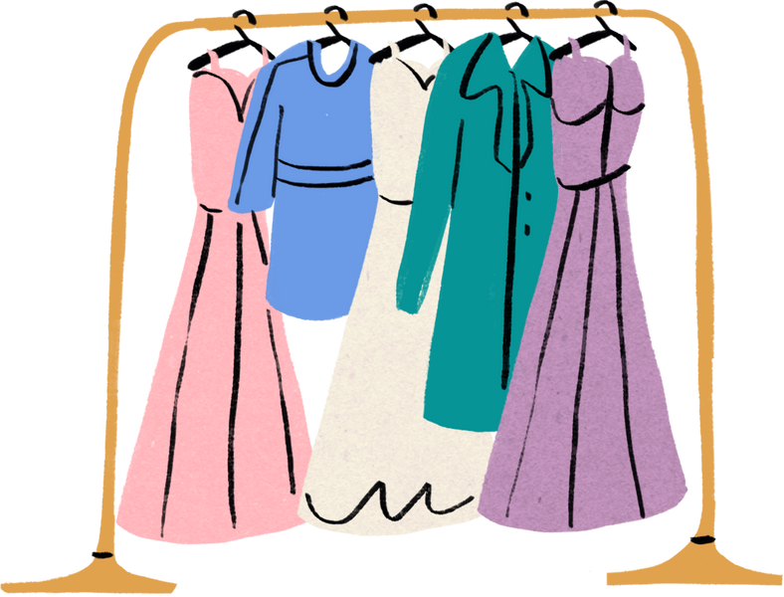
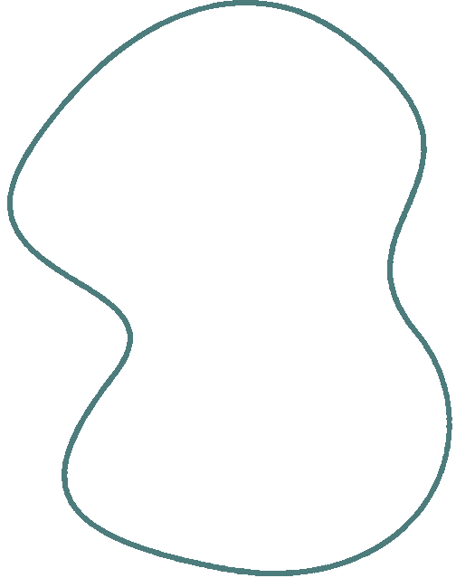
Objective
Utilize Convolutional Neural Networks (CNNs) to analyze and extract features from fashion images.
Enhance user experience by providing personalized fashion recommendations based on individual preferences.
Improve recommendation accuracy by leveraging deep learning techniques to understand nuanced style preferences.
Enable seamless integration of visual data analysis to suggest clothing items that align with user tastes and current fashion trends.
Optimize shopping journeys by offering tailored suggestions that anticipate and meet diverse style preferences.

Slide 5

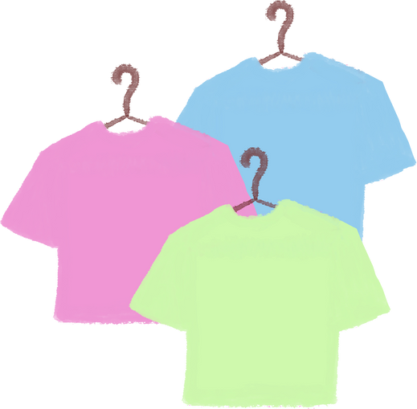
ResNet-50 has demonstrated outstanding performance in various computer vision tasks, including image classification, object detection, and image segmentation. It has been widely adopted in both research and industry due to its accuracy and efficiency.
Applications: Used in applications requiring high accuracy in image recognition tasks, such as identifying objects in photographs, medical image analysis, autonomous driving, and more..
An image representing the challenges and opportunities in optimizing fashion recommendations, showcasing the need to address ethical and privacy concerns.

Slide 6

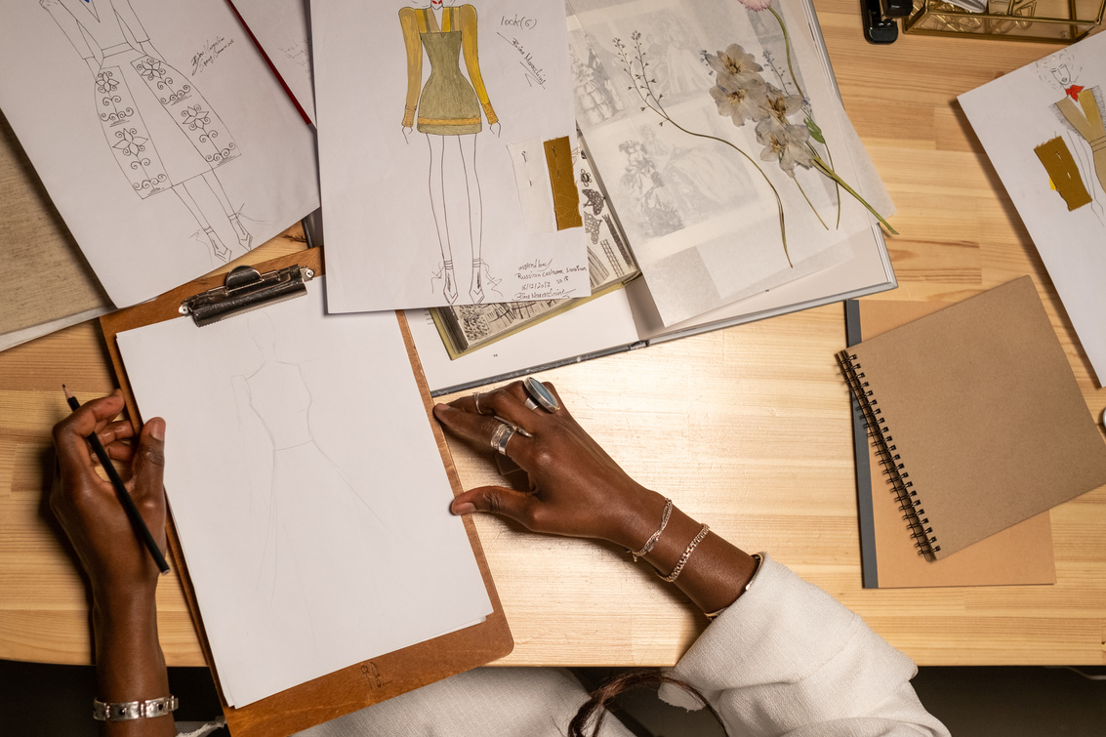
Algorithm involved
Nearest neighbor algorithm: The algorithm assigns the new data point to the class (for classification) or predicts the value (for regression) based on the majority class or average value of its nearest neighbors (k nearest points).
Content based algorithm: Content-based filtering uses item features to recommend other items similar to what the user likes, based on their previous actions or explicit feedback.
Distance Scores: The Euclidean distance score is shown to indicate how similar each recommended item is to the uploaded image.
User Upload Interface: The app is built using Streamlit , which provides a user-friendly interface for uploading images. -
Image Display and Recommendations: After a user uploads an image, the app displays the uploaded image and retrieves the top recommendations. For each recommended image.

Slide 7

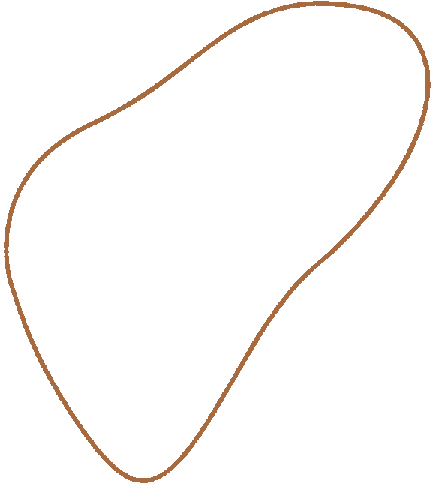
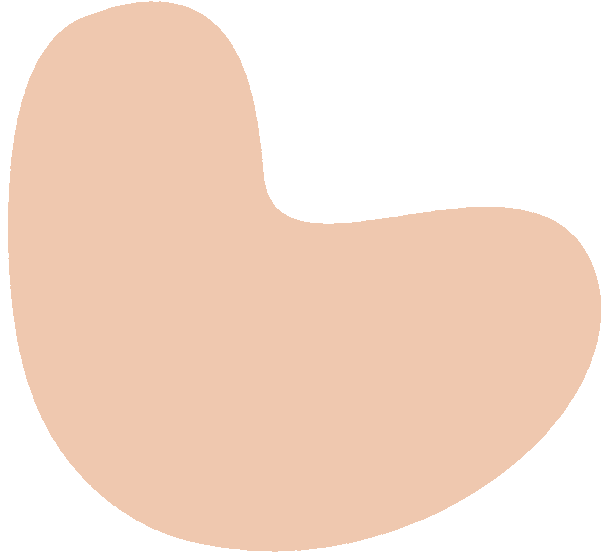
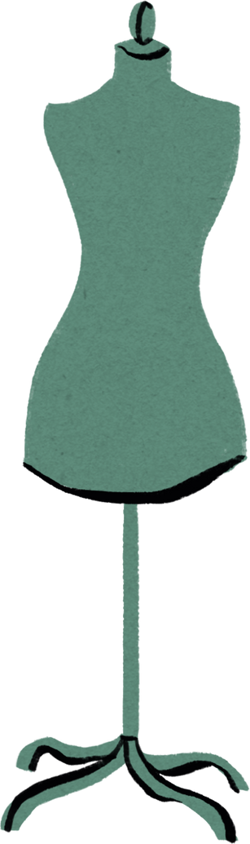
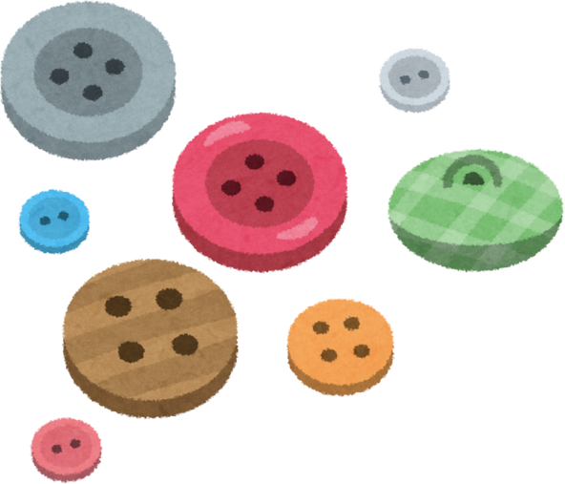
LIBRARIES INVOLVED
Tenserflow
Numpy
Streamlit
Pickle
Keras

Slide 8

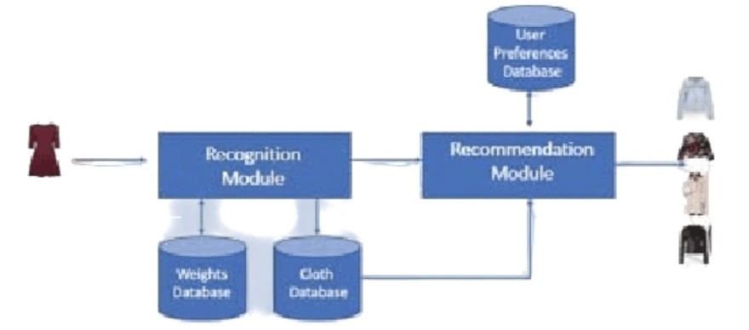
Methodology

Slide 9
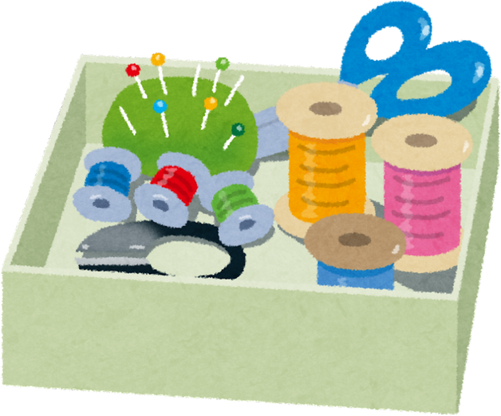
Personalized User Experience
Personalization is the key to creating a compelling user experience.
By leveraging advanced algorithms, we can tailor fashion recommendations to individual preferences, leading to higher user engagement and satisfaction.
The focus on personalization aims to create a seamless and enjoyable shopping journey.

Slide 10
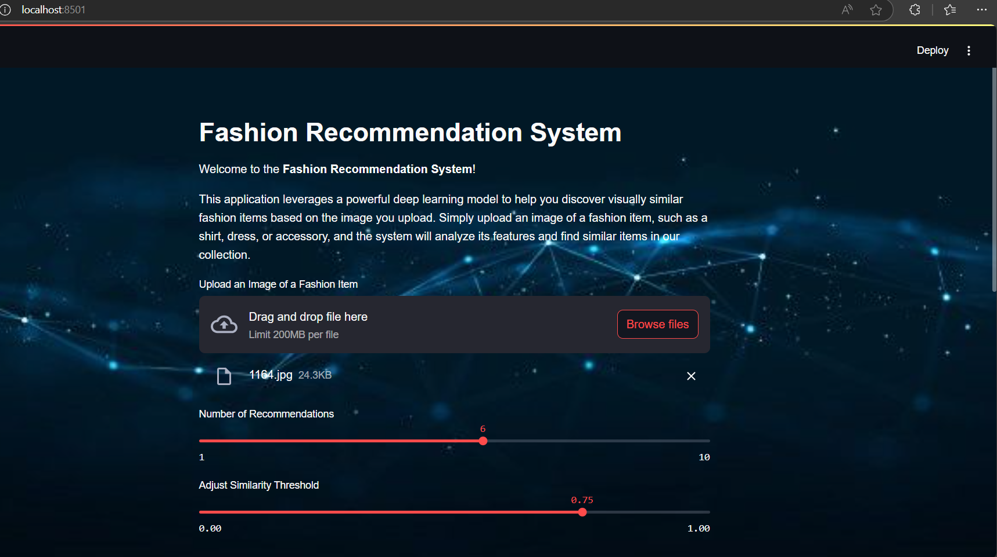
Output:

Slide 11
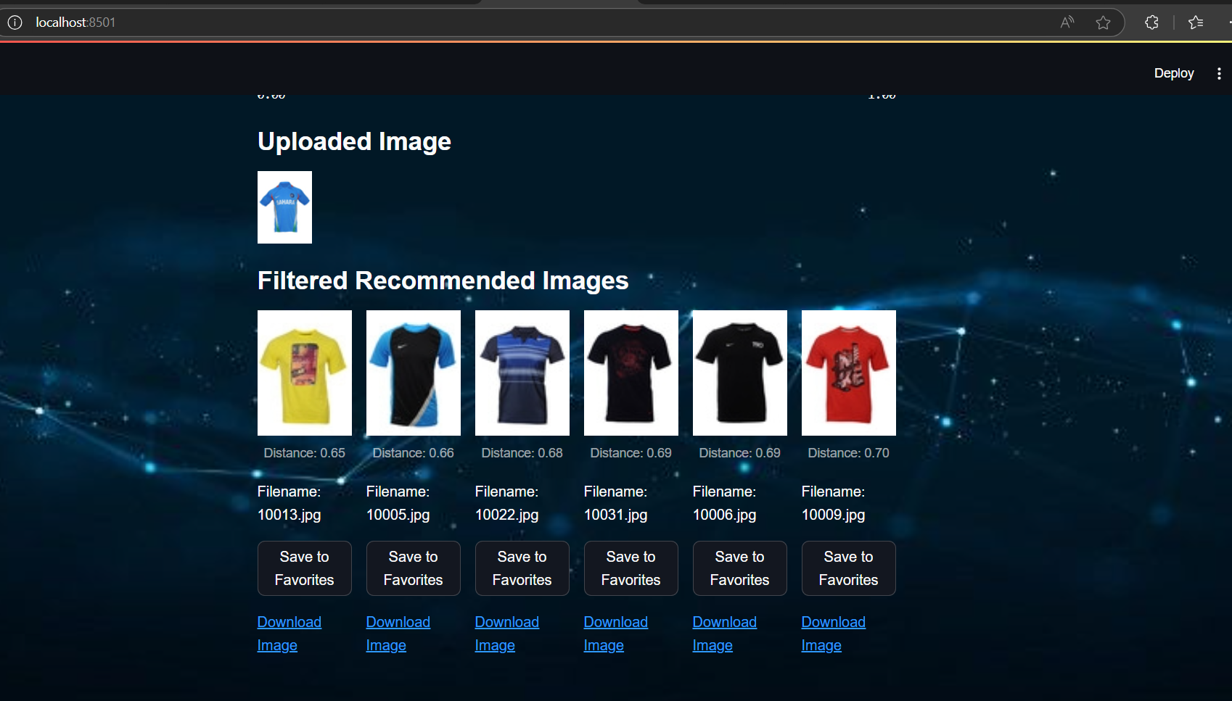

Slide 12

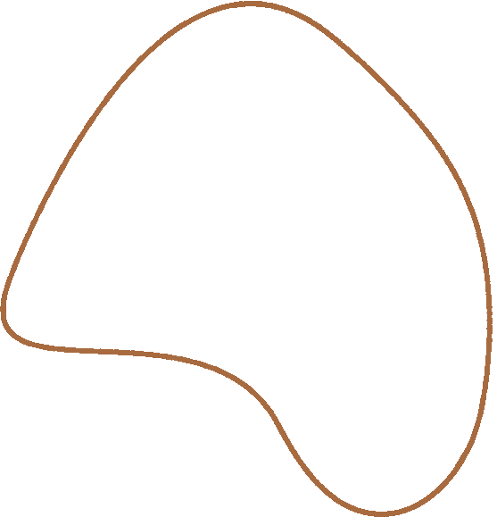
Conclusion
Well-designed fashion recommendation system leverages a combination of advanced algorithms to provide personalized and accurate suggestions to users.
By integrating Convolutional Neural Networks (ResNet-50) for visual feature extraction, collaborative filtering to learn from user behavior, content-based filtering for understanding item attributes, and nearest neighbor algorithms for finding similar items.
The system can cater to diverse user preferences and enhance their shopping experience.

Slide 13
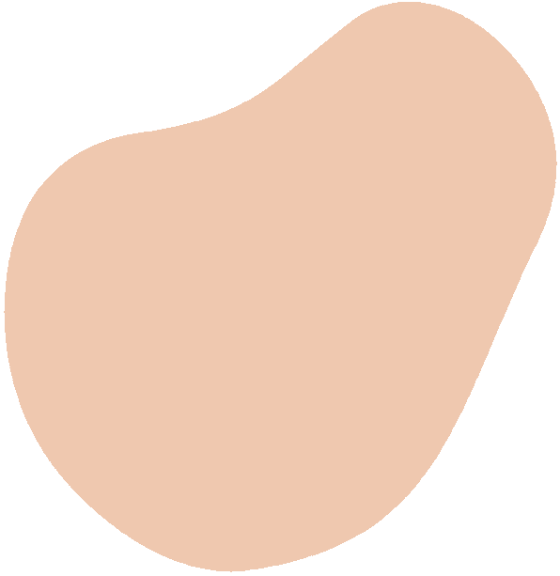
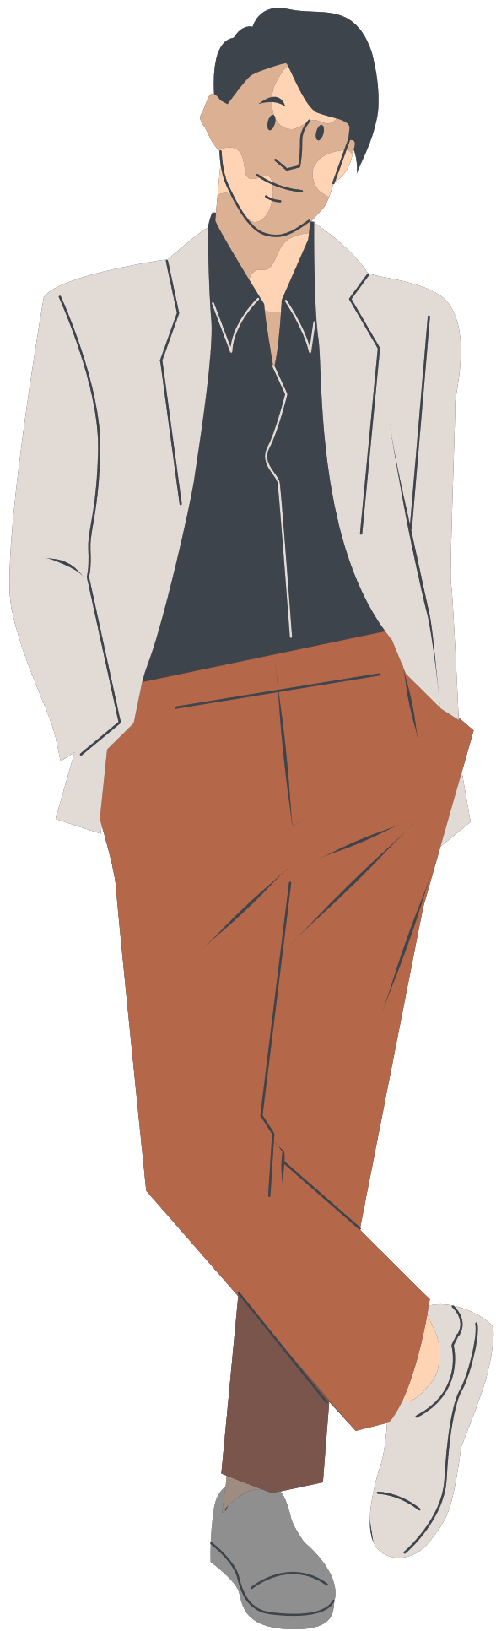
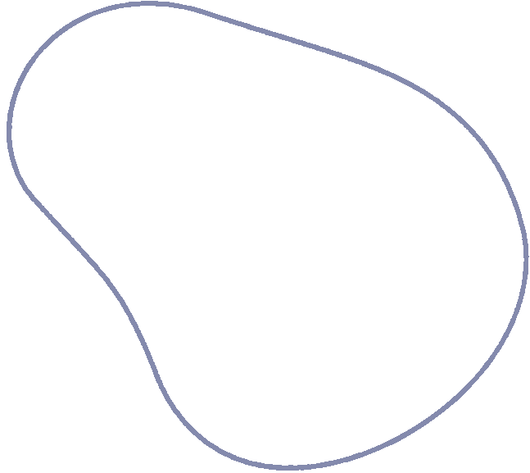
Thank you!

